Slide 1
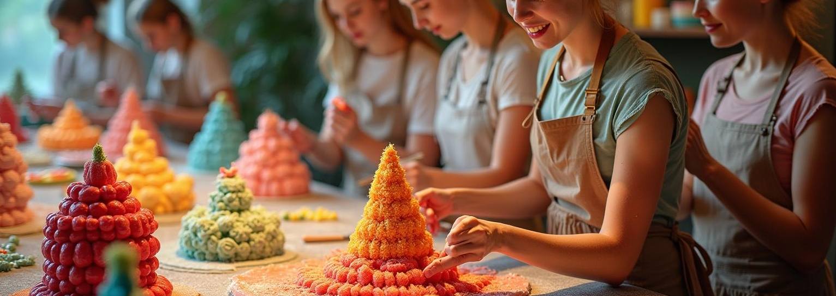
Edible Art Studio
Unleashing Creativity Through Edible Artistry

Slide 2
Introduction
Discover the unique concept of Edible Art Studio, where creativity meets culinary expertise. This innovative space offers a platform for individuals to craft their own edible masterpieces while also serving as a thriving business venture. From personalized creations to luxurious edible gifts, our studio promises a transformative experience that combines fun, learning, and artistic expression. Join us in shaping a new culinary trend that captivates all!

Slide 3
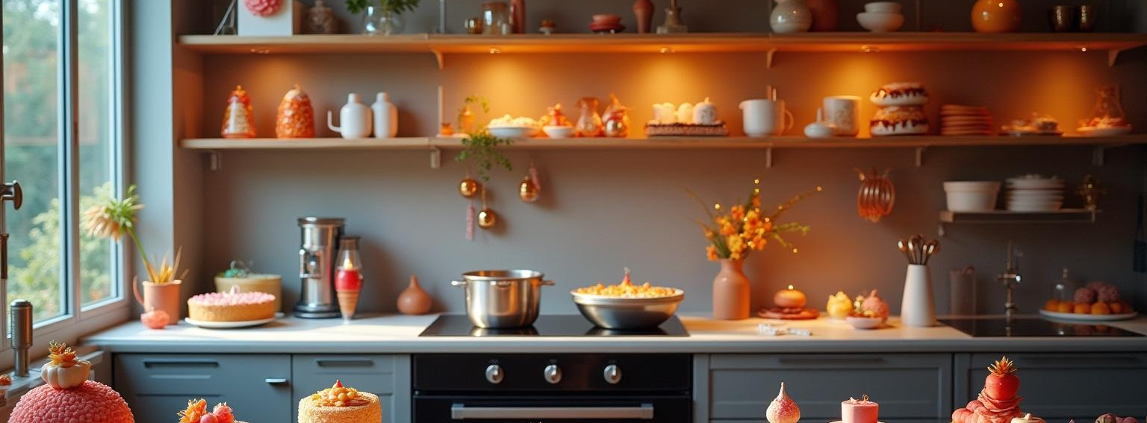
01
Edible Art Studio Concept

Slide 4
Creative Experience Studio
Welcome to a space where imagination flourishes! Our Creative Experience Studio invites guests to dive into the world of edible art. Participants will learn techniques to create stunning sugar sculptures and chocolate figurines. Through hands-on workshops designed for all ages, we foster an environment of creativity and enjoyment as customers bring their edible visions to life.

Slide 5

Business Venture
Edible Art Studio transcends being just a creative space; it operates as a dynamic startup. Our professional team will produce, market, and sell exquisite edible art creations, including custom candy sculptures and event décor. With a focus on innovation and quality, we establish a brand synonymous with luxury and creativity, catering to both individual and corporate gifting needs.

Slide 6
Interactive Studio Experience
Step into a realm of creativity and fun at our Interactive Studio Experience! Here, customers will learn the art of crafting their own candy, chocolate, and sugar sculptures. With a variety of workshops tailored for kids, families, and professionals, we offer an engaging platform where guests can express their artistic flair. Unleash your imagination and watch as your edible creations come to life in a delightful and memorable way!

Slide 7
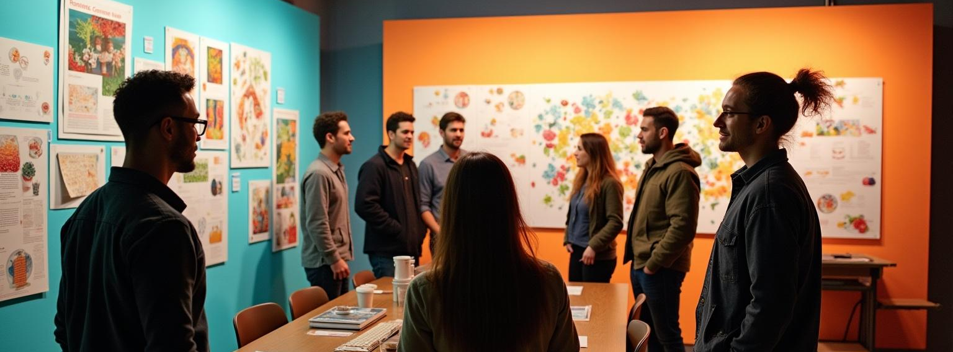
02
Business Model Opportunities

Slide 8
Studio Revenue Streams
Our revenue model is designed for sustainability and growth. We will generate income through entry fees for “Create Your Own Candy” sessions, alongside ticketed themed workshops. Additionally, we’ll host birthday parties, kids’ events, and team-building workshops, creating a diverse range of experiences that attract a broad clientele while fostering community engagement and creativity.

Slide 9
Product Sales
Maximize the reach of our artistic offerings through a variety of product sales. We will offer ready-to-buy designer edible sculptures and seasonal collections, such as Diwali sweets adorned with artistic sugar designs and festive candy ornaments for Christmas. By capitalizing on corporate gifting opportunities with logo-based candies and luxurious event décor, we will position ourselves in the premium niche of the market.

Slide 10
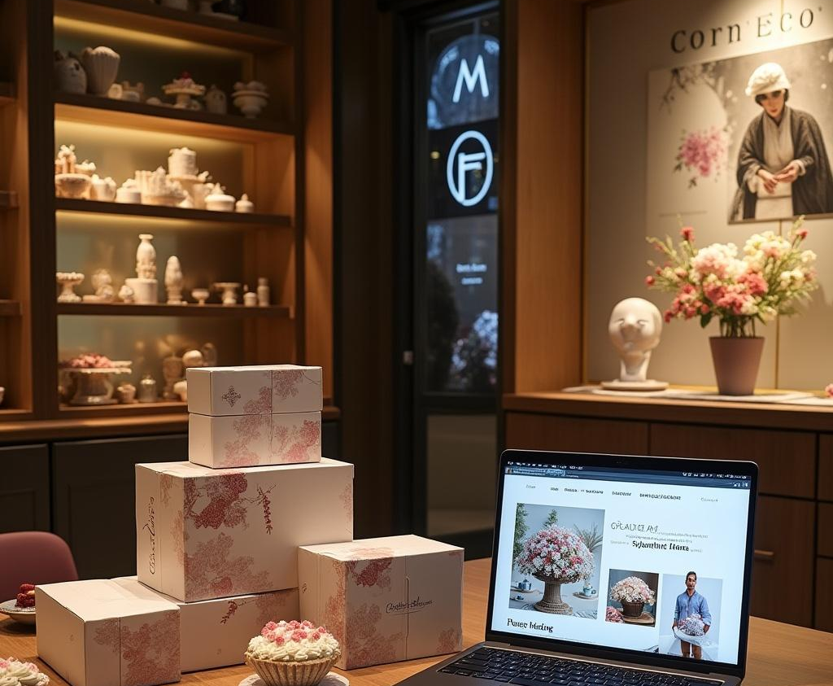
Online & Franchise Expansion
Embrace the digital era with our online strategy! We will launch an e-commerce store allowing customers to design and order their edible sculptures for delivery. Subscription boxes featuring “Monthly Artistic Treats” will attract engaged customers. Additionally, we aim to explore franchise opportunities, expanding the Edible Art experience into new cities and collaborating with international luxury brands for gifting.

Slide 11
Conclusions
In summary, Edible Art Studio blends creativity with culinary excellence, offering a unique experience that engages customers while driving sustainable growth. Our dual approach as a creative studio and business venture opens numerous pathways for profitability and brand expansion. Embrace the artistic journey and be part of a revolutionary concept in the world of edible artistry—where fun meets innovation!

Slide 12
Thank you!
Do you have any questions?
youremail@email.com

